Slide 1

About CIRCLE-IN
A Project of Cooperation
Giuseppina Passiante
Scientific Coordinator Laboratory of Management Engineering University of Salento

Slide 2

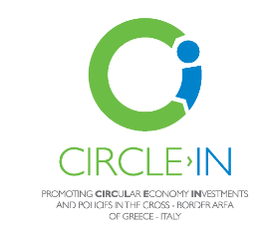
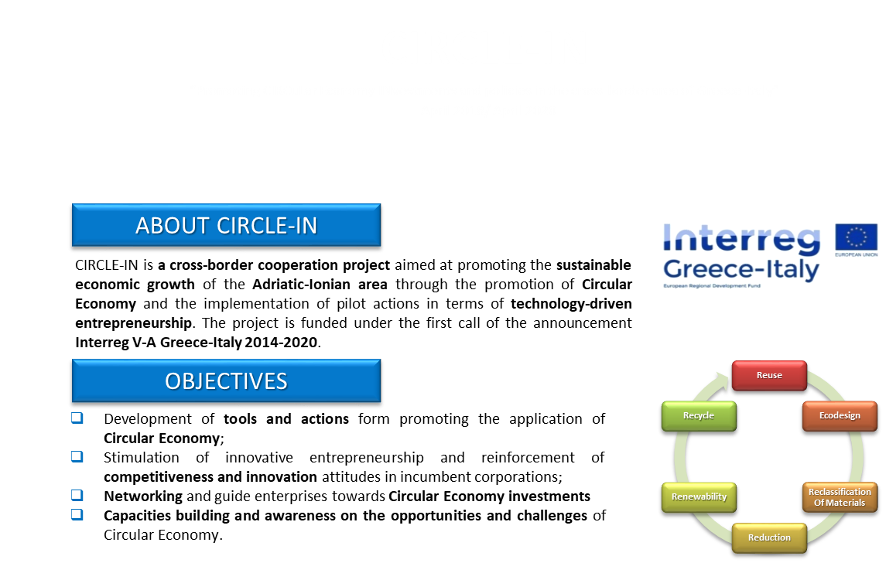
About CIRCLE-IN Project
“Promoting CIRCuLar Economy INvestments and policies in the cross-border area of Greece-Italy” - Project Code 5002953
April 2018/ April 2020

Slide 3
About CIRCLE-IN Project
“Promoting CIRCuLar Economy INvestments and policies in the cross-border area of Greece-Italy” - Project Code 5002953
April 2018/ April 2020

Slide 4
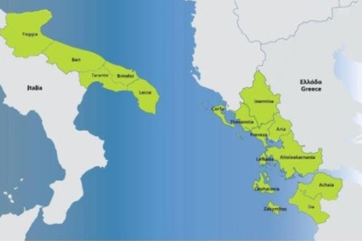




About CIRCLE-IN Project
MAIN ACTIVITIES
METHODOLOGIES
Needs’ assessment and readiness in the Adriatic-Ionian Area;
Focus on the state of the art in theory and practice;
Collection of best practices about Circular Economy;
Design and development of a project platform as virtual environment for sharing knowledge and practices;
Design of executive programs for developing competencies in the field of circular economy;
Launching of an open call for ideas’ competitions and awards for innovative entrepreneurial initiatives.
  The project embraces a research in action approach, based on :
  Desk and on field analysis;
  Interview and benchmarking;
  Focus Groups, networking and workshops.
RESULTS
  Increased number of investments in Circular Economy;
  Increased cooperation among local/regional/national stakeholders;
  Mentoring, training and counseling services;
  Innovation Vouchers’ program.
CIRCLE-IN
PROJECT PARTNERSHIP
Chamber of Commerce of Ioannina (lead partner)
Chamber of Commerce of Lefkada
Chamber of Commerce of Foggia
University of Salento, Laboratory of Management

Slide 5
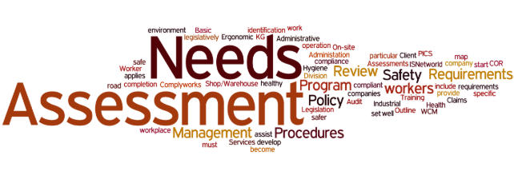
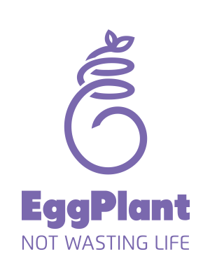
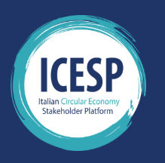
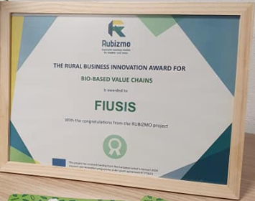
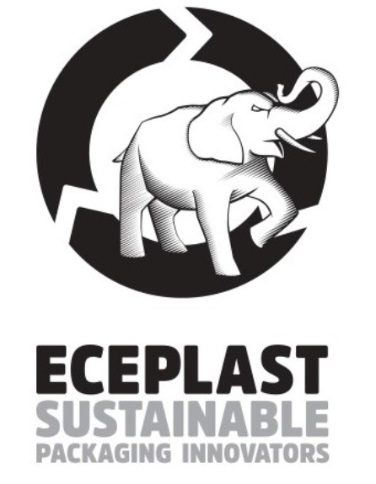
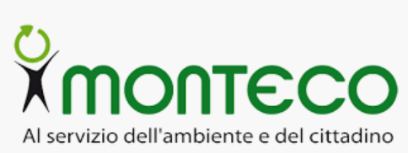
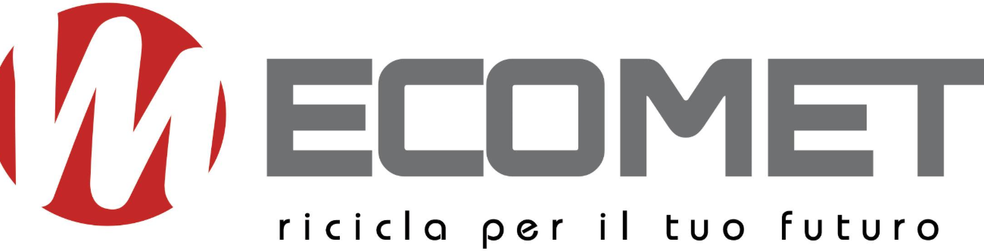
CIRCLE-IN Project: first results
Needs assessment, readiness and state of the art about Circular Economy in the Ionian –Adriatic Area
Identification of best practices in terms of Circular Economy Innovative Entrepreneurship

Slide 6
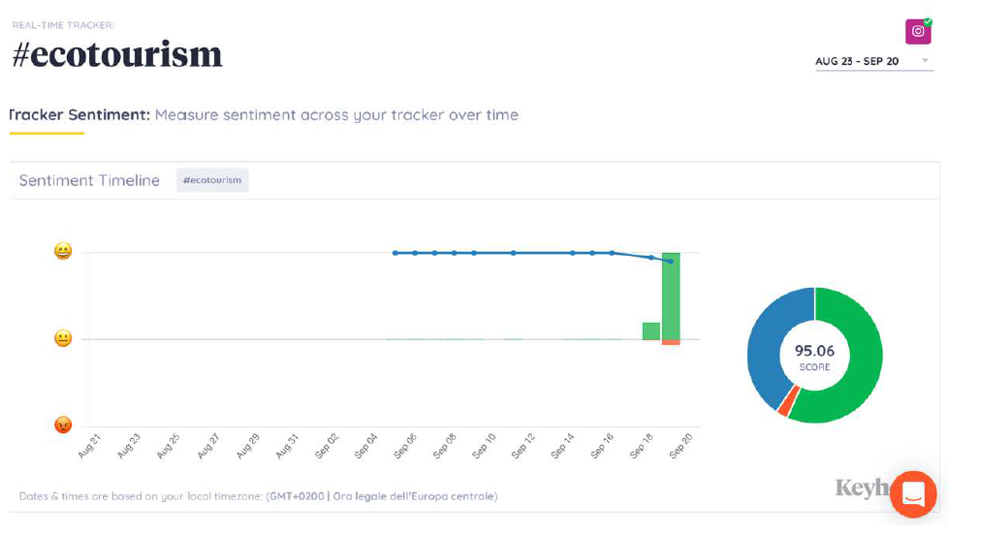
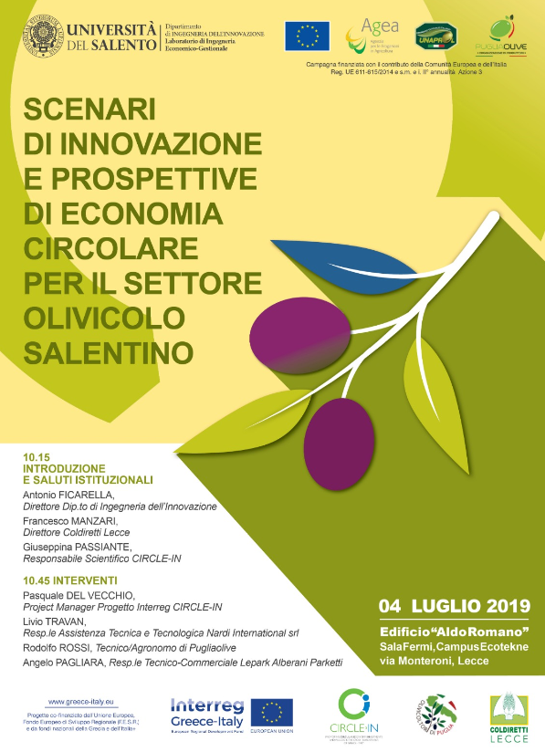
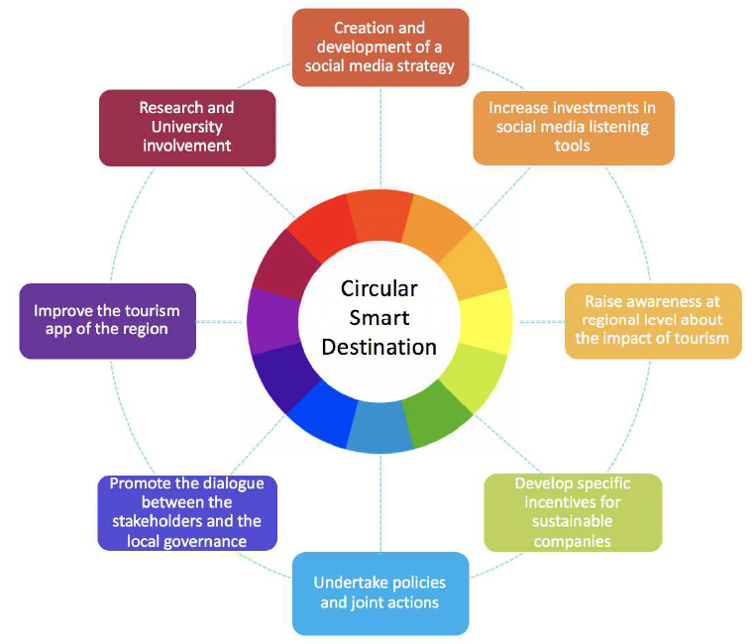
CIRCLE-IN Project: some results
Analysis of scenarios of development for the Circular Economy in the field of Agro-food and Tourism
Green Hotels and Facilities in the Ionian Adriatic Area

Slide 7
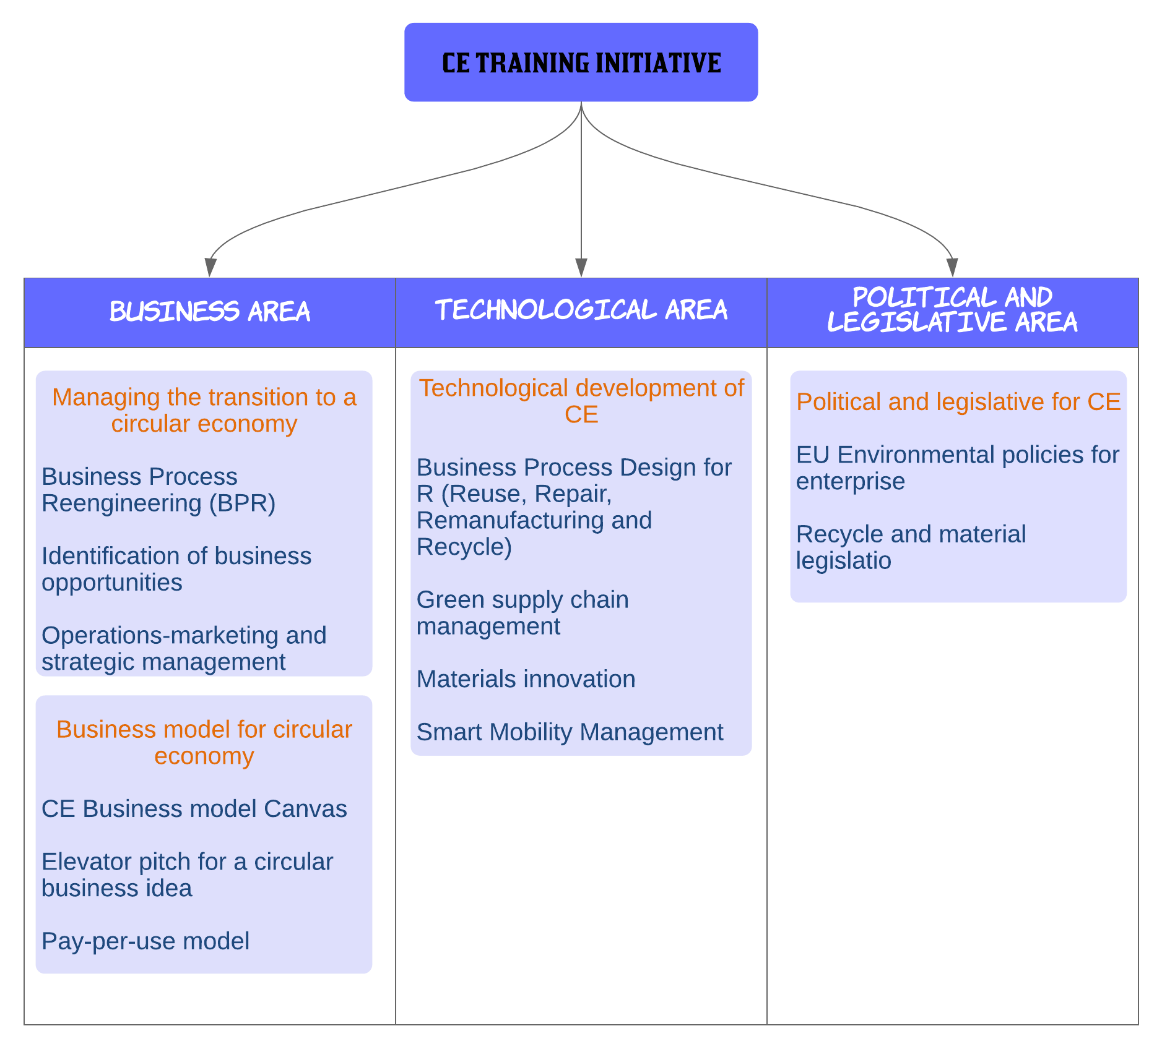
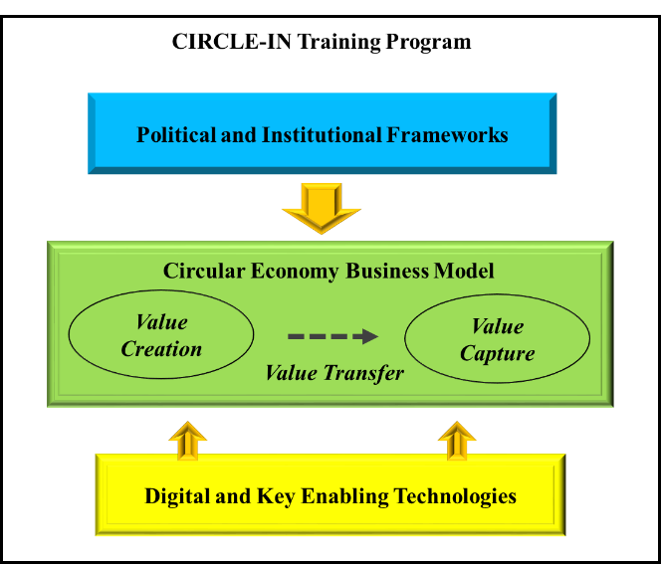
CIRCLE-IN Project: first results
Designing of an Advanced Training Session on Circular Economy Innovative Entrepreneurship

Slide 8
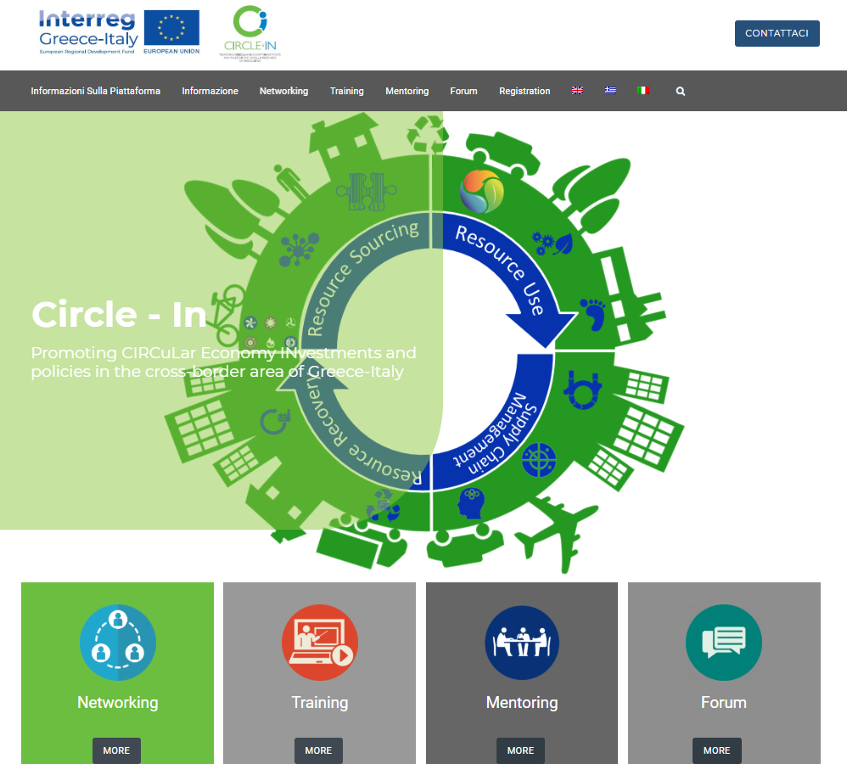
CIRCLE-IN Project: some results
Designing and Development of the project web platform
http://platform.circle-in.eu/it/

Slide 9
Thanks for the Attention!!
https://www.facebook.com/InterregCIRCLE.IN/
https://www.facebook.com/laboratorioingegneriaconomicogestionale/
https://www.facebook.com/interregreeceitaly

